Slide 1


Languages for All
Languages, Cultures & Societies
Students without Borders (SWB)
Background & Rationale
Aims
Programme
Lessons
Assessment and Marking criteria
Student’s Feedback

Slide 2

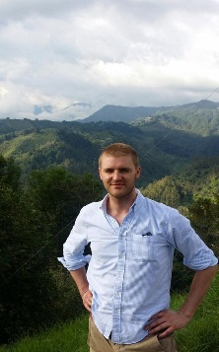
Background and Rationale
Languages for All
Languages, Cultures & Societies
In 2012, Colin Coulter, prepared an online questionnaire for all year 1 and 2 medic students
An outline for a module was developed with the title “Students without Borders”
Course began in September 2013 with French and Spanish

Slide 3
Background and Rationale
Languages for All
Languages, Cultures & Societies
Extra-curricular module – independent of the degree. Fee £295
It is for year 1 and 2 students of Medicine, Dentistry and Healthcare, specific focus on medical vocabulary and contexts.
AS/ B1 CEFR (Common European Framework)
for both Spanish and French

Slide 4
Languages for All
Languages, Cultures & Societies
Aims
Remind, refresh and develop their knowledge of Spanish/French
Work in a hospital, medical setting, in a Spanish/French speaking country.
Develop a range of transferable skills
Practise medicine in the Spanish/ French language

Slide 5
Languages for All
Languages, Cultures & Societies
Programme
Two-hour class weekly: plus two hours independent study
17:30 – 19:30
It runs for a full academic year (Oct – May)
Based on a syllabus, developing four skills (R/W/S/L)
Content include medical reports and practical clinical cases following the suggestions and needs of students

Slide 6
Languages for All
Languages, Cultures & Societies
Lessons
News related to medical issues
Present their news 10 first minutes of each lesson
Present a medical case: cardiac system, parts, diseases, symptoms, causes, possible solutions
Role play
Follow by an individual medical written report as a homework for the following week.

Slide 7
Languages for All
Languages, Cultures & Societies
PROGRAMME
Syllabus (Scheme of Work)
See Syllabus

Slide 8



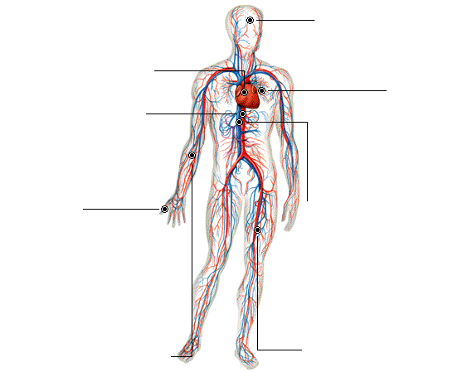
Languages for All
Languages, Cultures & Societies
Lessons
Mira el siguiente diagrama y llena con las
palabras que faltan
C
O
R
A
Z
O
N

Slide 9


Languages for All
Languages, Cultures & Societies
ASSESSMENTS
Semester 1
Firstly, formative, individual written assessment, about
any medical topic of the student’s choice

Slide 10

Languages for All
Languages, Cultures & Societies
Secondly, summative, it has two parts:
written task (50%)
is an individual reflection of their professional objectives and personal goals
students should pick their subject according to their chosen medical vocation
Length: +/- 1200 words
In Semester 2

Slide 11
Languages for All
Languages, Cultures & Societies
Marking Criteria 20/90 – Writing task
Outstanding 80 - 90 | Content 50%
 | Structure | The overall structure is excellent, clear and coherent. Arguments are developed and linked in an excellent, logical and well-organized manner.
 | Analysis, critical thinking. | Outstanding evidence of analysis of the case study researched. Describes compares and explains with outstanding critical thought.
 | Language 50% Accuracy | An outstanding range of grammatical structures appropriate with the level – e.g. tenses, agreement, word order, conjunctions.
 | Vocabulary | Student uses an outstanding range of general and specialized vocabulary relevant to the case study.
 | Style and register | Outstandingly effective and authentic use of medical terms. Appropriate register is used at all times. Outstanding flow of ideas.

Slide 12
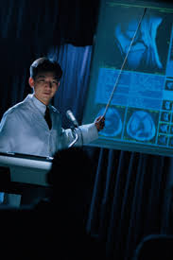
Languages for All
Languages, Cultures & Societies
oral presentation
A researched clinical case related to a specific pathology
In pairs
Filmed
20 minutes in total
Exam period May-June
mms://iss-video.leeds.ac.uk/SMLC/llc/fl/Spanish/Julia/JP050615_2b.wmv

Slide 13
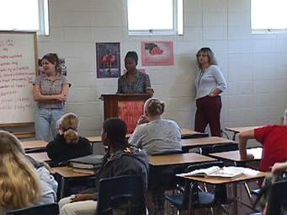
Languages for All
Languages, Cultures & Societies
Marking Criteria Oral Presentation
Content 50%
(content, organisation, delivery)
Language 50%
(vocabulary, grammar/accuracy, pronunciation/ fluency)
To pass Students need 40/90 for both tasks

Slide 14
Languages for All
Languages, Cultures & Societies
Student’s feedback
Alex Strother (Year 1, Medicine) talks about the Students without Borders experience:
The workload is very fair and homework from the course has never interfered with medicine work.
The atmosphere in classes is very relaxed too, which is great.
Something that I have especially enjoyed has been getting to know students in other year groups and on different courses,
While providing a slight break from medicine, at the same time everything we learn in class is very relevant, and I do feel that through researching all of the conditions or organ systems we studied, my wider knowledge of medicine in English has also improved.
I would 100% recommend the course to anyone and hope to keep it up next year!
Heather Goodacre – Year 2 Medical Student
Students without borders is a great course to immerse yourself in Spanish vocabulary and scenarios that otherwise you may not get the opportunity to learn.
It is a course that focuses on medical Spanish: learning about conditions; ways to approach consultations and extensive specific vocabulary. Throughout the course, all aspects of language are taught – speaking, listening, reading and writing.

