Slide 1
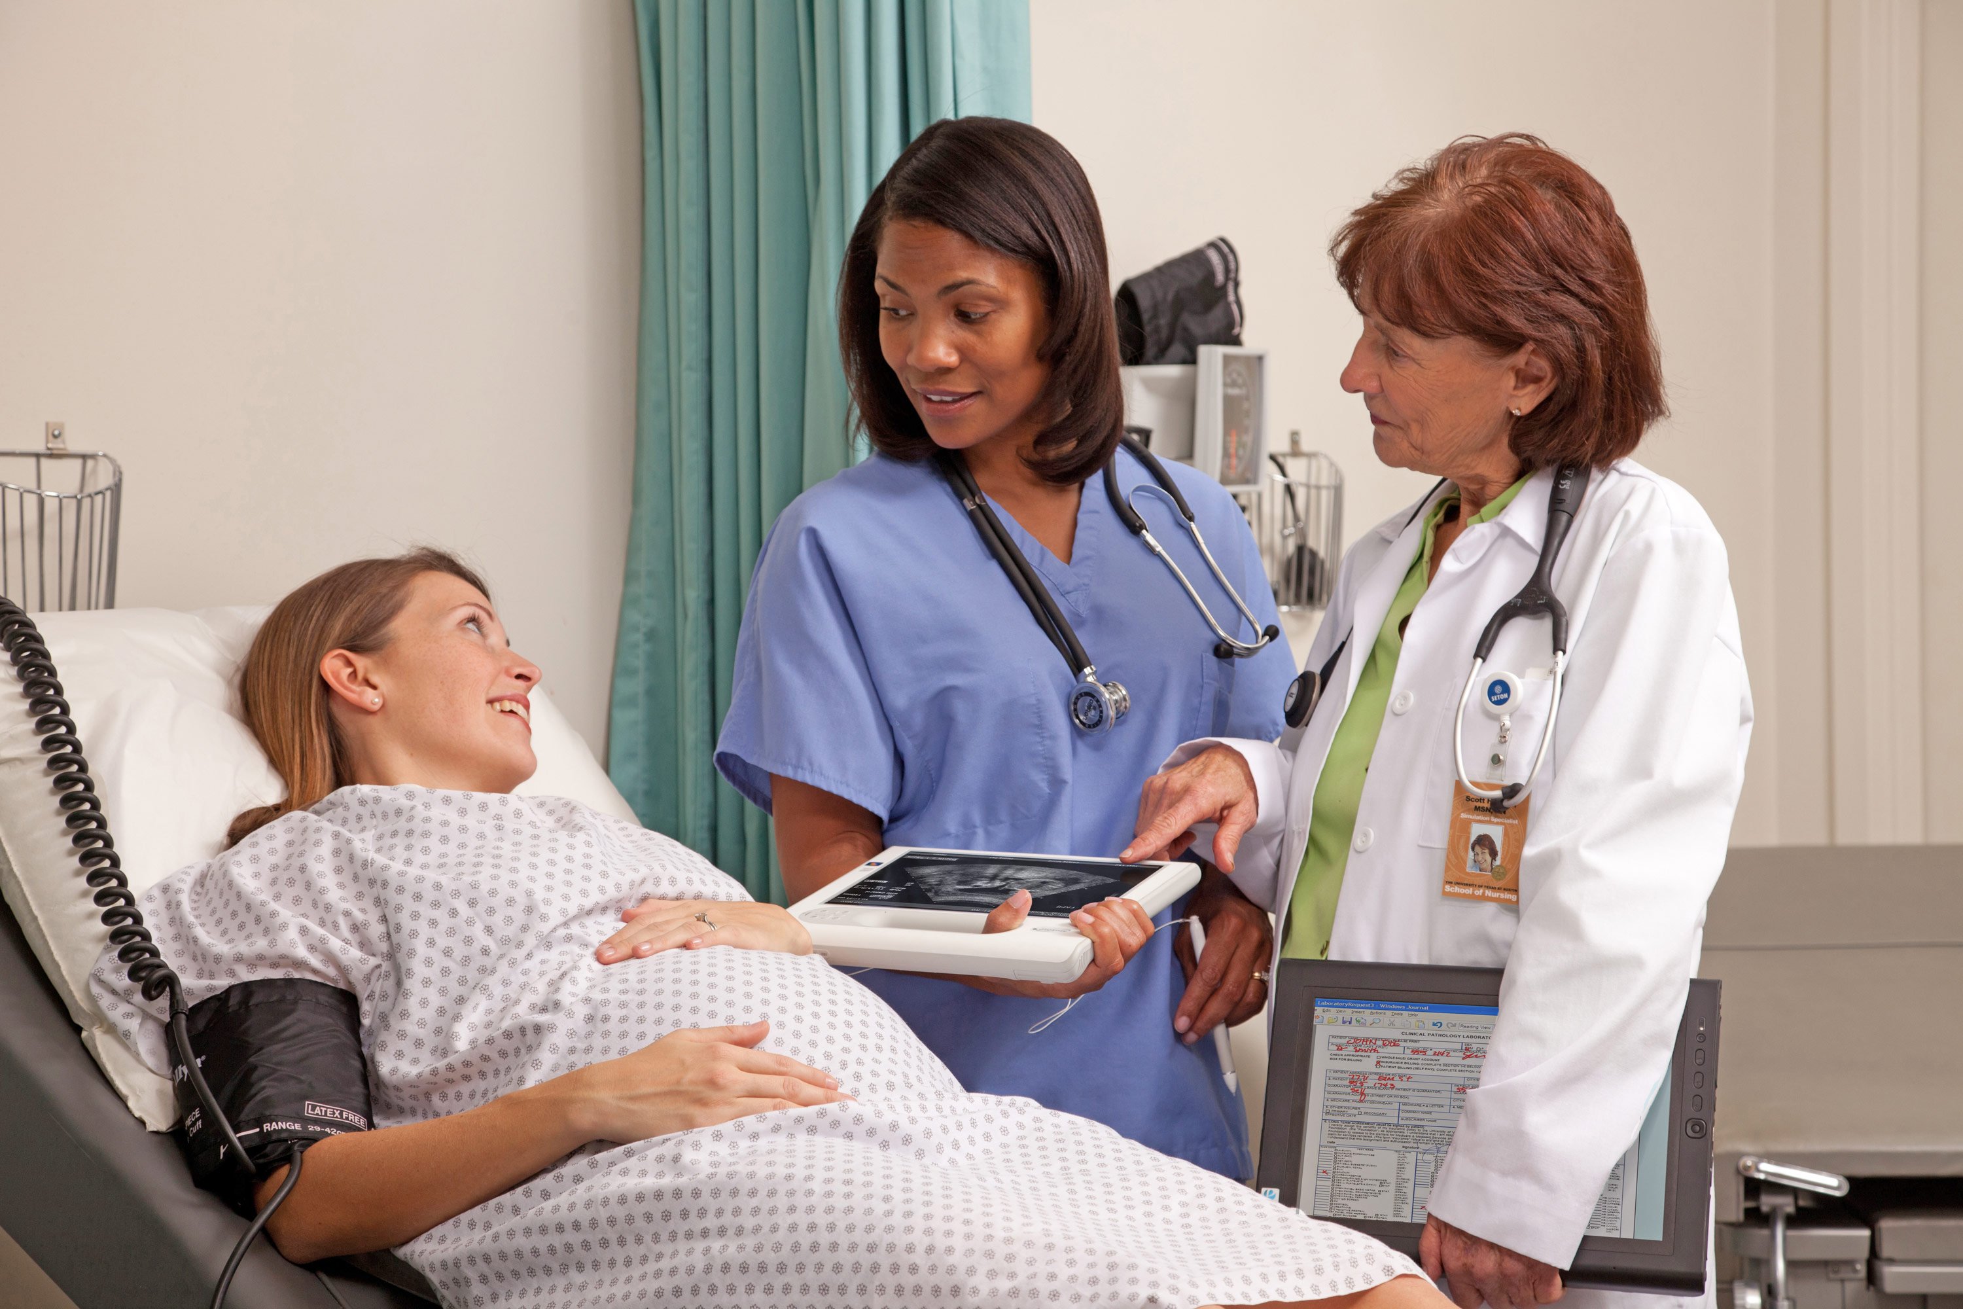
French for Medics Beginners

Slide 2
background information
Offered as a One Term Module (10 weeks).
30 hours of face to face and 10 hours of e-learning component.
Students are expected to spend 5-7 hours per week as independent learning.
Content of the course:
A medical content on top of what is covered in Stage 1.
Very condensed syllabus but students are prepared to continue learning French in stage 2.
An e-portfolio in line with the material covered in class.

Slide 3
Objectives
Create a learning environment where students have the opportunity to mobilize their linguistic knowledge to convey meaning.
Activities are very much connected to real-life situations to be as practical as possible and can be introduced as soon as the first sessions.
The activities are goal-oriented, communicative in nature.

Slide 4
For Example (session 2)
Greetings and presentations: role play at the emergency room
Situations:
A. Student A : you work at the reception of the A&E (emergency room) where you need to register patients. Student B : You are fourteen years old and need to be registered before being able to see a Doctor.
B. Swap roles- Student B: you work at the reception of the A&E (emergency room) where you need to register patients. Student A: You are fifty years old.

Slide 5
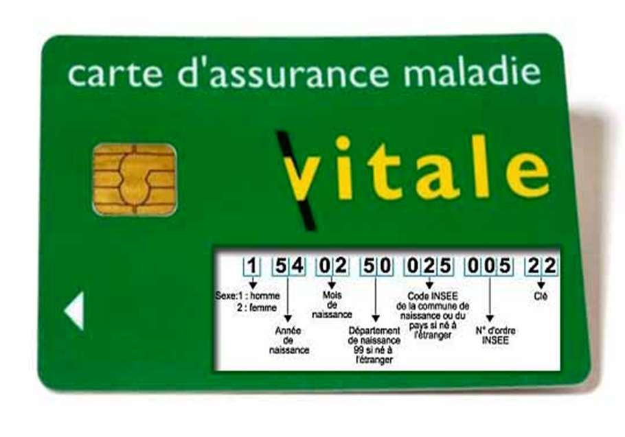
For Example (session 2)
Registration Form to be filled:
Nom : Formal/ informal
Prénom :
Téléphone :
Adresse email :
Numéro de carte vitale:
@ = arobase
point (gmail point com)
Notes:
Content covered in class to be remobilized:
Greetings and how to introduce yourself
Numbers
Spelling
A formal or informal way to address patients according to the situation.

Slide 6

MEDICAL Topics COVERED over the term
Medical professions and hospital departments
Body parts
Benign health issues (cold, flu)
Common symptoms: headaches, fever, vomiting, etc.
Common medicines
At the Doctor’s office
At the pharmacy

Slide 7

Materials
Textbook (general content)
Authentic documents
Online resources

Slide 8
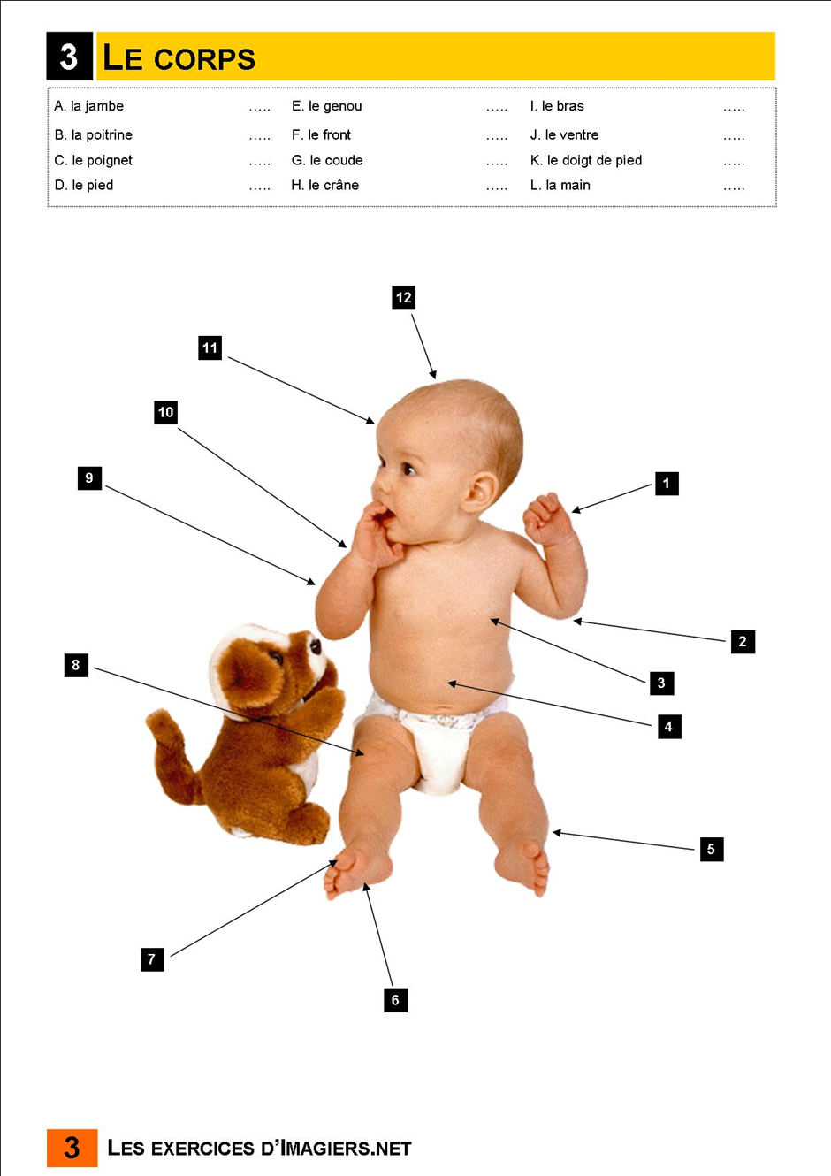
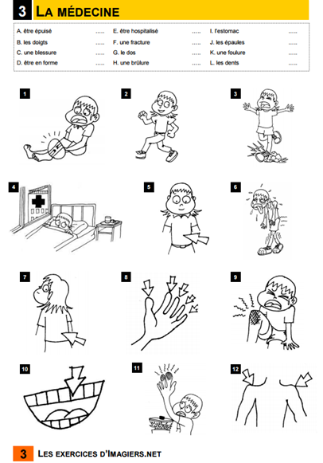
Vocabulary sheets done in class
Notes:
In pairs, students had to associate the picture with the word/ expression.
Source: imagiers.net

Slide 9
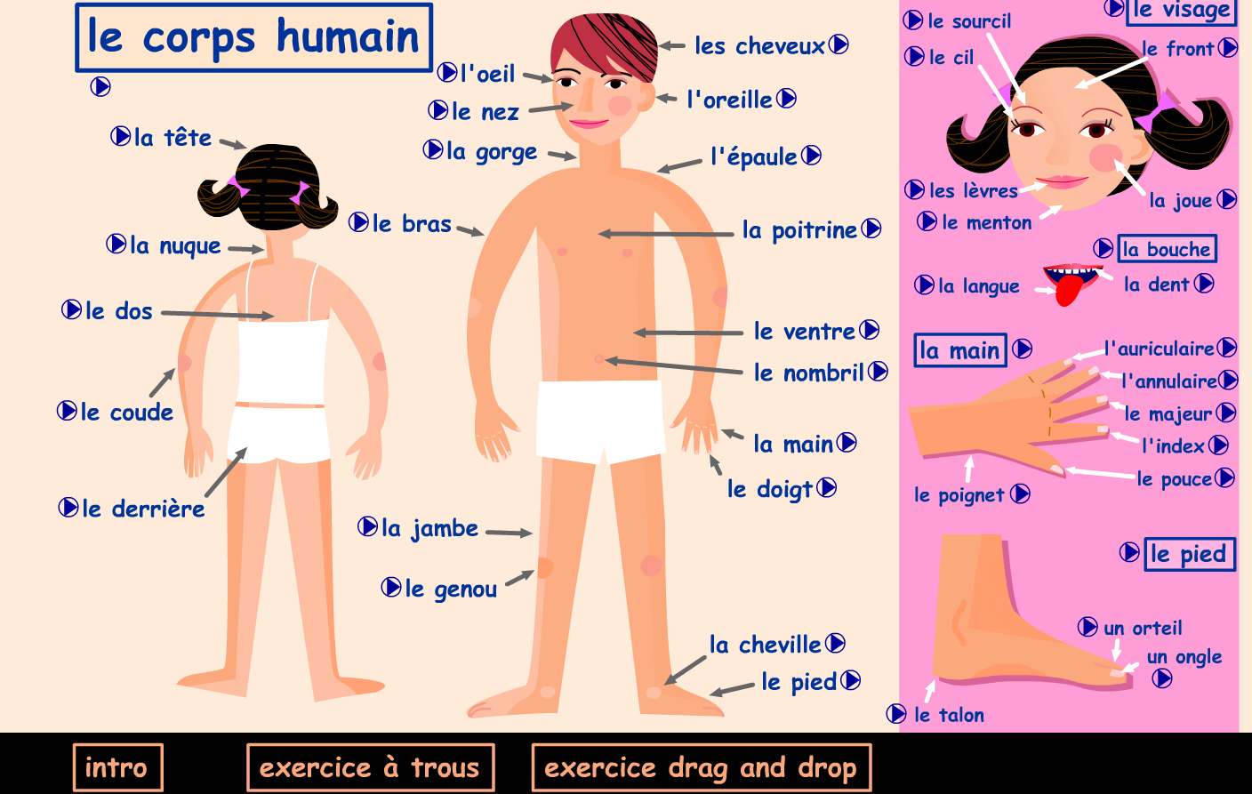
E-learning
Notes:
Students can practiced their pronunciation by clicking on each word and memorize the vocabulary at their own pace.
Other exercises are also provided so they can test themselves.
Source: http://www.maisondequartier.com/pedagogie/corps_voca/p_voca_corps.php?lang=en
Other source: http://www.languageguide.org/french/vocabulary/body/

Slide 10
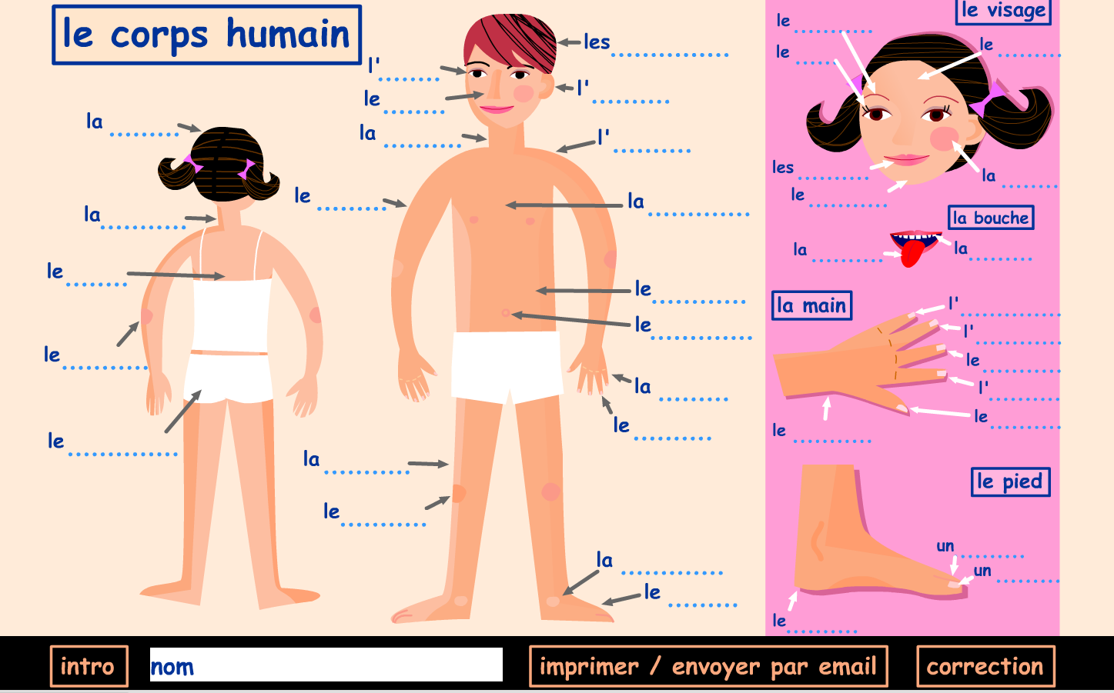
E-learning

Slide 11
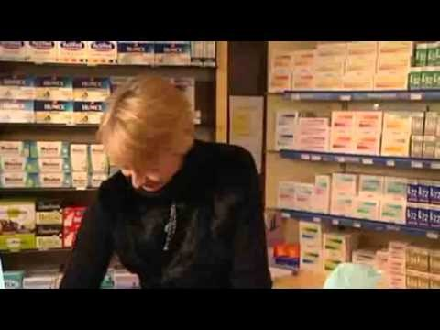
Authentic documents At the Pharmacy
Notes:
Show the first 27 seconds.

Slide 12
Authentic documents
Authentic documents are rich linguistic and cultural pedagogical resources:
Focus on visual clues.
Listening comprehension questions in line with their linguistic abilities.
Cultural differences (medicines you can obtain over the counter).
Introduce new medical lexicon or review in context vocabulary previously studied.

Slide 13

Audio documents introducing new vocabulary
– What brings you here?
– I fell and hurt my arm.
– Can you remove your vest? Let’s see. Indeed, it’s swollen. When did you fall?
– This morning, I went down the stairs and missed a step. I put an ice pack on it, but the pain is only getting worse.
– Is it hurting now?
– Here, it’s a little better compared to earlier.
– We’re going to do an x-ray
…
– You have a fracture (in your arm).
– Will it be fractured for a long time?
– At least six weeks if your arm remains completely stationary.

Slide 14
Listening comprehension
1) Students listen to an audio-document and focus on the medical aspects:
Where is the dialogue taking place?
What is the problem?
Students share in pairs what they were able to understand.
2) Students listen to the document a second time and answer the questions in pairs.
What is Sylvia’s health issue?
How did it happen?
What are the symptoms?
Is she in pain?
What is the Doctor’s diagnostic?
How long will the recovery take?
3) Post- activity to expand students’ vocabulary / expressions (transcript of the dialogue if necessary).

Slide 15
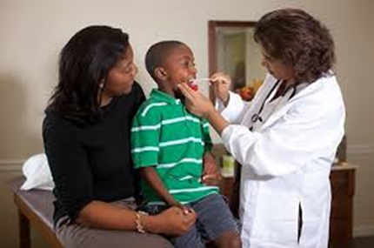
THE TASk
At the doctor’s office:
your first consultation in French

Slide 16
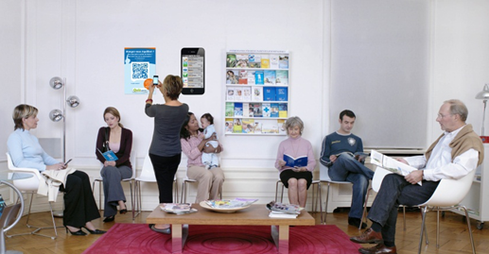
Warm up activity
In your opinion, why are these people waiting to see the Doctor ?
- Introduce the topic of the task
Recall medical vocabulary.
Brainstorm about potential situations to prepare the task.

Slide 17
The CONTEXT Conduct your first consultation in French
As a Doctor
as a patient
You are a junior Doctor and replacing a Doctor in a French Doctor’s office during the holidays.
You will need to fill out a patient form (surname, first name, date of birth, weight and height).
Ask about the health issue, how it happened.
Family histories about health conditions/ life style/ exercising.
Potential allergies.
Diagnostic.
Recommendations/ treatment.
You need to see a Doctor.
Create an identity (name, age, weight, etc.)
Think about your health issue, your family history about health conditions, your life style, exercising.
Your allergies.
Ask questions about how long recovery will take, potential side-effects, questions you may have about the treatment.

Slide 18
Learning context
The warm-up activity has allowed students to brainstorm about potential situations.
Each student prepares two scenarios: as a patient and as a Doctor.
They prepare the activity on their own but have the opportunity to ask the instructor or each other questions on linguistic issues.
Students will need to rely on their medical knowledge as well as their linguistic skills.
Detailed feedback is provided and does not focus solely on linguistic errors.

Slide 19
POTENTIAL Follow-up activities
As homework:
Students need to write a clear prescription specifying their medical instructions.
On a forum: How to avoid getting sick in the winter… advice from Dr. …..

Slide 20
COnClusion
The task is goal-oriented as students have to provide a clear diagnostic, offer recommendations and be able to explain a treatment.
To convey meaning, students rely on knowledge acquired in class but also outside class such as:
Their medical knowledge
Their linguistic knowledge in French:
Use of all tenses (present/ passé- what happened/ future- what will the side effect be)
Display their ability to ask and answer questions
Reuse in context medical vocabulary (medicine, illnesses, symptoms, etc.)
Their cross-cultural competence: carte vitale, payment, a diagnostic that is culturally plausible, etc.
Notes:
One Doctor suggested his patient to go to the Pharmacy directly…

Slide 21
Advantages
The teaching approach based on simulation is similar to their medical training and is designed to be very practical. The hands-on tasks enhance students’ motivation.
The pedagogical approach is student-centred: students are highly engaged in the task and gain agency. The instructor’s role is to guide them in their learning process.
Room for improvement: the e-portfolio should be re-designed around medical tasks.

Slide 22
Thank you

