Slide 1
Italian for Medics 1
Task based approach at Beginner Level
Modern Language Centre – King’s College London
barbara.rocci@kcl.ac.uk

Slide 2
Italian for Medics 1 basic information
Assessed Module aimed at UG Medical students (40 hours = 2hs a week per 20 weeks)
Syllabus: same grammar topics and functions as a standard beginner class + specific vocabulary and function related to medical professions
Resources: course contents and resources have been developed ad hoc by Italian teachers at the MLC between 2007 and 2009 and constantly updated (resources include printed materials, audio and video recordings and on-line interactive exercises)
Assessment: Oral (health related discussion on a visual stimulus) and Written exam (reading comprehension, use of language in context, writing)

Slide 3
Italian for Medics 1 pedagogical approach
Task based and communicative approach
Students are engaged and are asked to complete ‘real-life’ tasks prioritising communication over formal accuracy per se
Resources are often derived from authentic materials and expose students to real communicative situations such as those they might encounter if working in an Italian hospital or surgery

Slide 4

Healthy habits and lifestyles: Giving advice
Aims and objectives of the unit
Reinforcing and consolidating conversational skills in relation to interviewing patients on their family history
Reinforcing and consolidating vocabulary and expressions related to daily routine and habits
Familiarising with vocabulary and expressions concerning general pathologies
Using modal verbs to give advise
Revising and consolidating reflexive verbs
Consolidating the formal Lei

Slide 5

1. Warm up
Students watch an authentic video from an Italian commercial and they associate with it as many words as they can remember connected to daily routine and habits

Slide 6
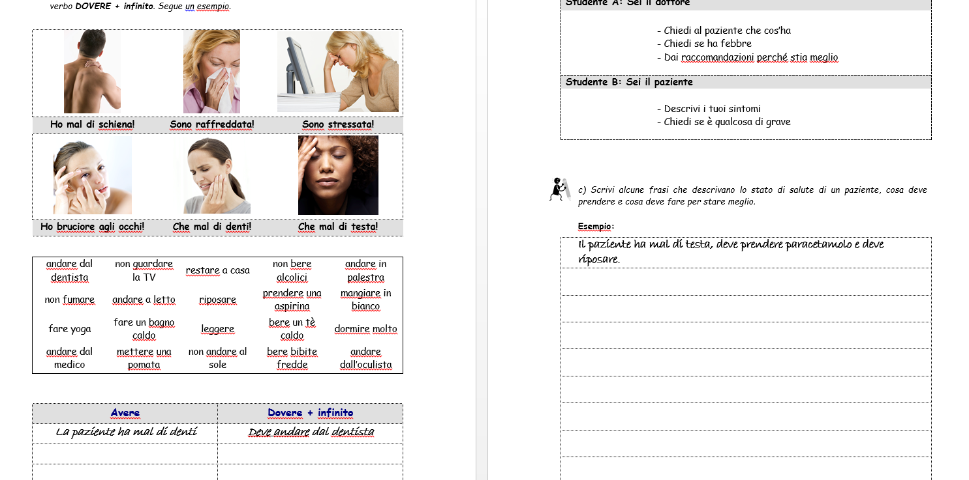
2. Input – Global and analytical comprehension – Analysis of specific structures and practice

Slide 7
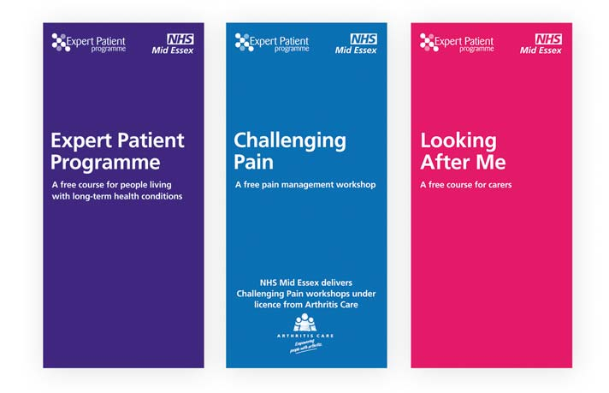
3. ‘Real-life’ task
Students design in class a questionnaire on lifestyle and daily habits in Italian for potential patients
For homework students interview an Italian peer (for example an Italian medical student) by using the questionnaire and they write down the answers
In class, following session, they work in groups comparing and contrasting their answers and they select the most recurrent ones
Students design a leaflet to be distributed in GP surgeries with specific advices for Italian students living in London…

Slide 8
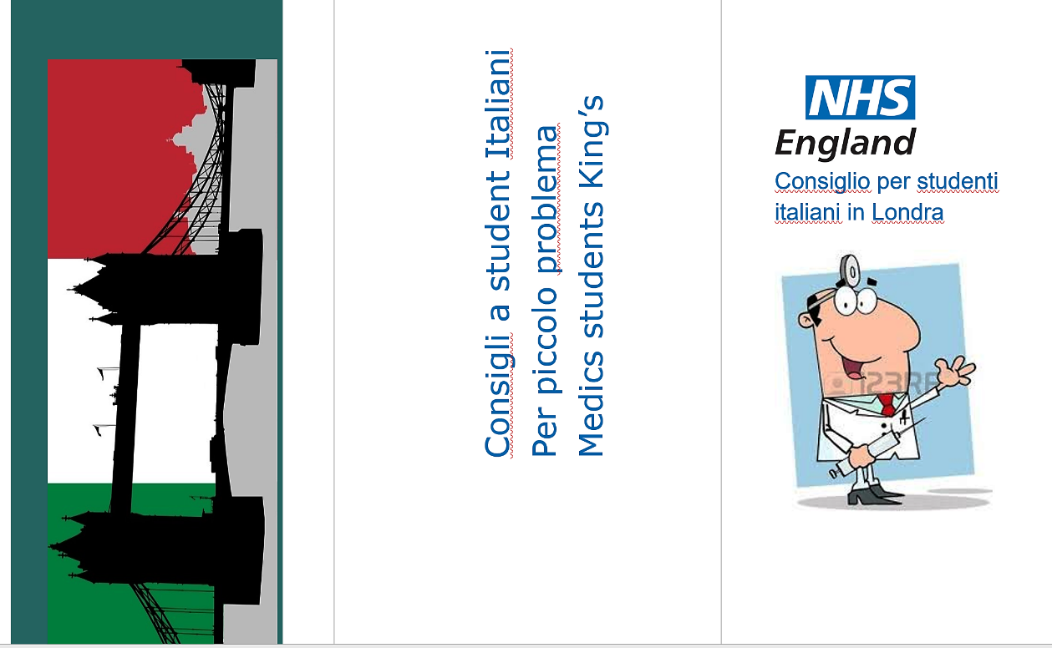
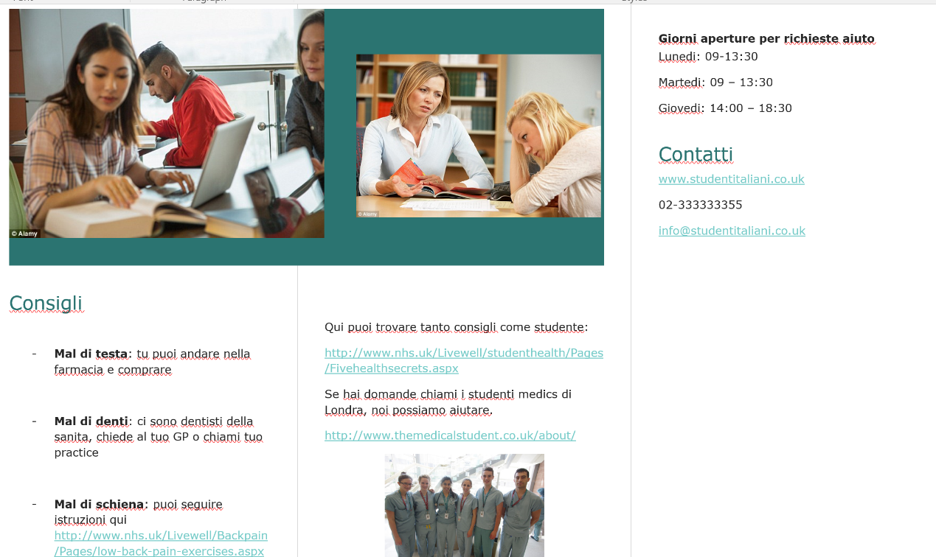
One of the leaflets prepared by the students

Slide 9

Advantages
Students are engaged in activities that encourage them to communicate in the TL at very basic level, but in a context similar to the one they will encounter in the target country as part of their medical training
Students work with simulation based learning, which is coherent with the pedagogical approached used in their medical training (so they can activate transferrable skills)
Students practice all linguistics skills at once: reading, writing, speaking and listening
The unit is ‘easy’ to realise, it does not require special equipment or complex instructions

Slide 10
Thank you ☺

