Slide 1

Languages for Specific Purposes in Higher Education 2016
Getting medics on the task
Hélène Butz

Slide 2

French for medics level 5 (B2): flipped classroom system
Objectives
Means
Teaching techniques
Conclusions

Slide 3
Objectives
Transferring student’s communicative and lexical competences in the medical field into French
Helping students develop / pursue their career
Putting the emphasis on MEDICINE

Slide 4
Means
Observation of documents
Triggering real-life professional situations
Learning structures to speak about French and international medical culture and ethics

Slide 5

Teaching techniques
Systematising the twofold approach of a flipped classroom

Slide 6
1) At home
Online articles / videos to prepare with a reading / listening guidance grid
Contemporary specialist and vulgarisation press
➔ Introduce the topic
➔Serve as the basis for small group discussions at the next class

Slide 7
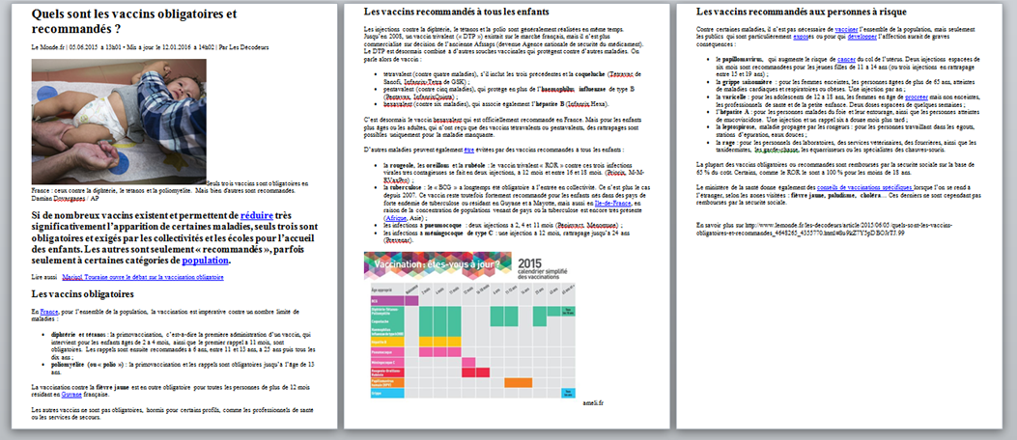
Example of text prepared at home
Vulgarization article
http://www.lemonde.fr/les-decodeurs/article/2015/06/05/quels-sont-les-vaccins-obligatoires-et-recommandes_4648265_4355770.html

Slide 8
2) In class : extended topic discussion
Group discussions with emphasis on analysis and expression of opinion
Open questionning from teacher to trigger reflexivity
Use of ad hoc structures

Slide 9
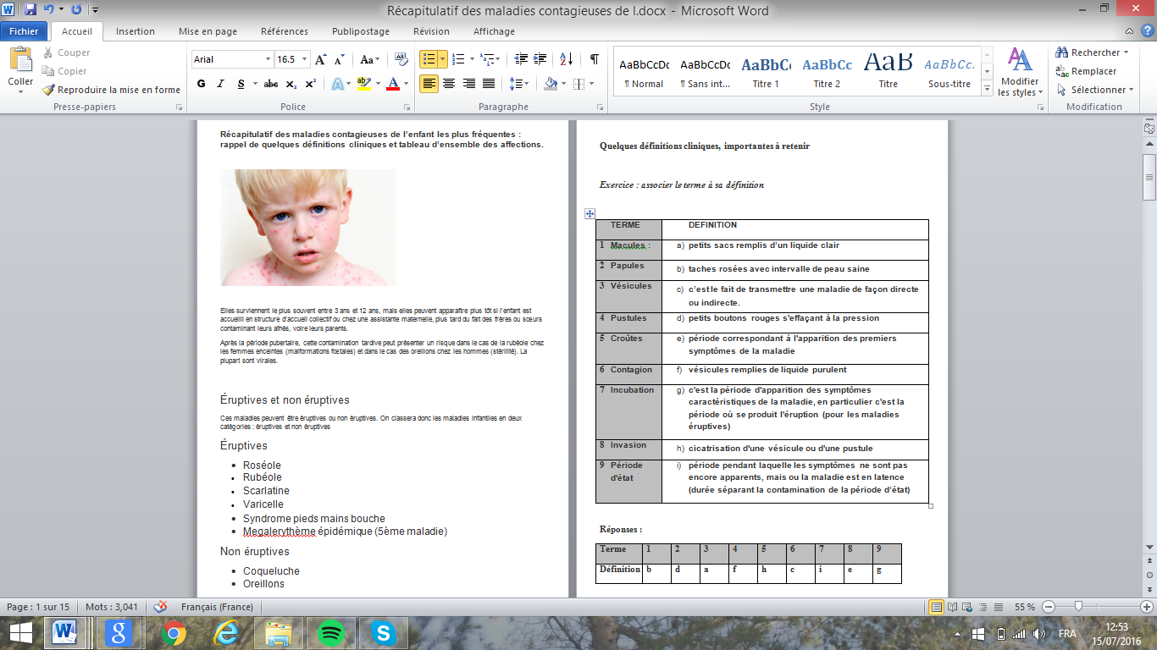
3) In class : series of tasks to prepare role play
Matching exercise : matching specialist terms with their definition.
Example :
specialist text taken
from online
paediatrics course
Document used : « Cours - Pédiatrie - Les maladies contagieuses de l’enfant », Emmanuelle LEFEBVRE – MAYER, www.infirmiers.com

Slide 10
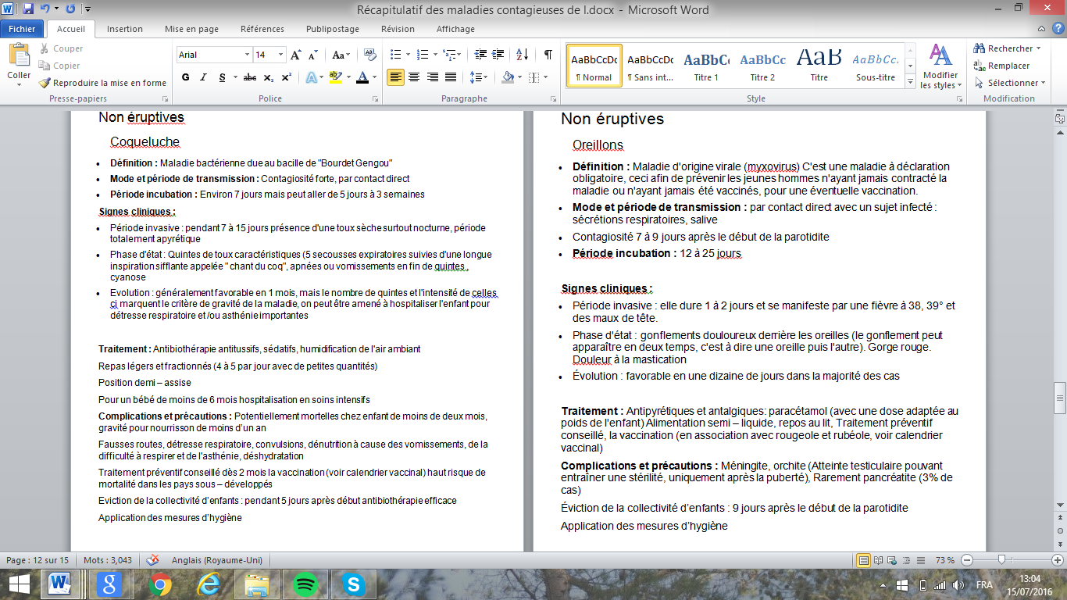
3) In class : series of tasks to prepare role play
B) Paraphrasing exercise: reformulating specialist terms into lay language.
Example of technical cards on childhood’s contagious disease
Each pair has a different card

Slide 11
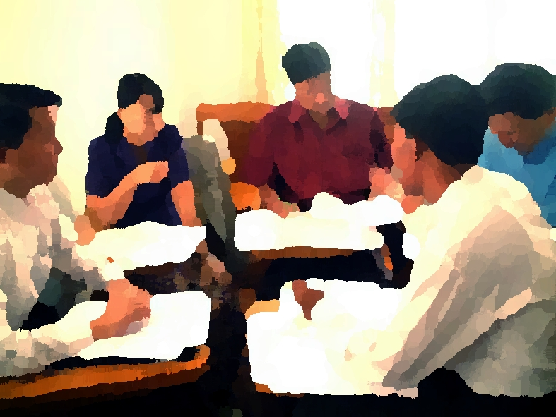

4) In class: role play and game
Each pair is invited to demonstrate a consultation diagnosing the disease they have become specialist of.
The rest of the class is offered the possibility to recognise the disease.

Slide 12
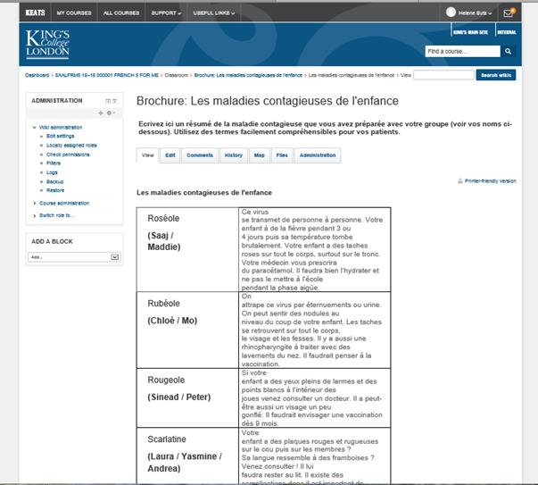
5) At home: writting task

Slide 13
Conclusion
Systematised scheme promotes
- Reflexivity
- Personal investment
- Autonomy of learning
French fully integrated in their studies

Slide 14
References
Boyatzis, R. (2006) : An overview of intentional change from a complexity perspective. http://www.emeraldinsight.com/loi/jmd
Moirand, S. (1990) : Régularités et variabilités des discours de la médecine, The (E)specialist vol. 11. Sao Paulo : cepril.
Mourlhon-Dallies, F. (2003): Former à enseigner le français de spécialité : l’exemple du français médical, Les Cahiers de l’Asdifle, 14, 175-192.
Rouleau, M. (1995) : « La langue médicale : une langue de spécialité à emprunter le temps d’une traduction », TTR : traduction, terminologie, rédaction, Volume 8, numéro 2, 29-49

