Slide 1

From Business to Enterprise
Claude Trégoat
Senior Teaching Fellow – French – The Language Centre

Slide 2
Context
Course: French for Business – Advanced 3 (content / entry: C1 CEFR)
Students: from a variety of departments and with diverse profiles
Financial constraints (year-long to part-year course)

Slide 3
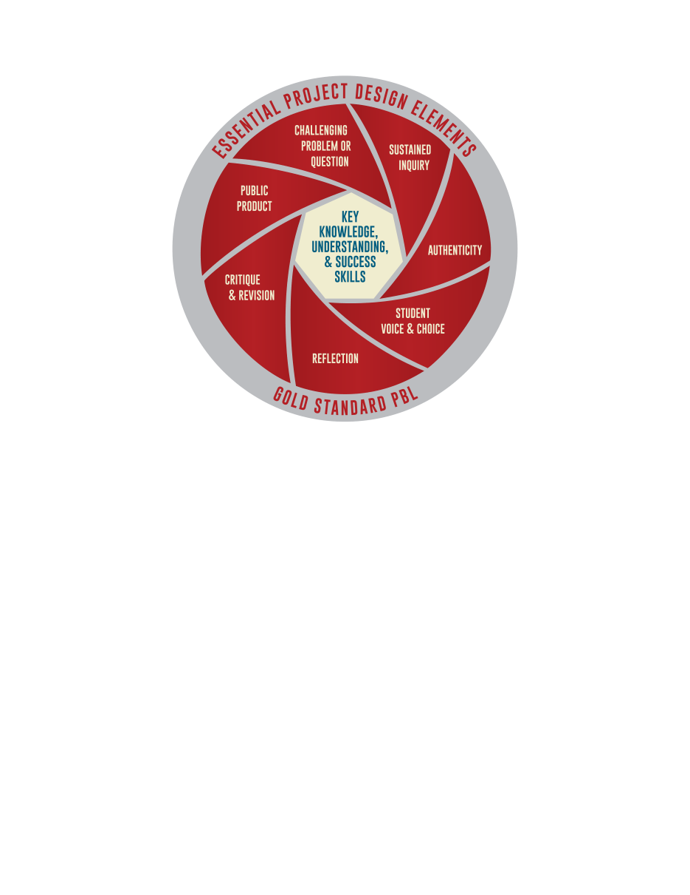
French for Enterprise
Brief: Develop a real business concept and take it through to a business plan – the project must be sustainable.
Buck Institute for Education: http://www.bie.org/object/document/why_we_changed_our_model_of_the_8_essential_elements_of_pbl#

Slide 4
Pedagogy
Tap into intrinsic motivation
Top of Bloom’s Taxonomy https://cft.vanderbilt.edu/guides-sub-pages/blooms-taxonomy/ : Challenge students’ creativity and resourcefulness
Self-directed Learner: For students to manage and take responsibility for their learning
Self-determined Learner: learners have more autonomy over what they learn – choose a project that fits their own interests – that is personally meaningful.
Idea of the “Entrepreneurial Learner”: “... is constantly looking for new ways, new resources, new peers and potential learners to learn new things.”

Slide 5
What the Research says – Some references
Motivation & Project-based learning: Blumenfeld, P. C.& Krajcik, J. S. (2006). Project-Based learning. In R.Keith Sawyer (ed) The Cambridge Handbook of the Learning Sciences: Motivation. Cambridge: Cambridge University Press.
Self-directed and cooperative learning: Kohonen, V. (1992). Experiential language learning: Second language learning as cooperative learner education. In Nunan, D. (ed.) Collaborative Language Teaching and Learning. Cambridge: Cambridge University Press.
The Entrepreneurial Learner: Seely Brown, J. (2015). Cultivating the Entrepreneurial Learner in the 21st Century. Accessed May 2016 http://www.johnseelybrown.com/el.pdf
Project-based pedagogy for languages: Beckett, G. H. & Chamness Miller, P. (eds) (2006). Project-based second and foreign language education, Past, Present and Future. Connecticut: Information Age Publishing.

Slide 6
French for Enterprise
Brief: Develop a real business concept and take it through to a business plan – the project must be sustainable.
Session & Business Plan – Tightly sequenced and scaffolded meaningful units:
Business/executive summary
Business opportunity (product or service)
Market analysis
Marketing and sales strategies
HR
Company profile
Financial information
Operational strategies

Slide 7
Examples of Students’ Projects
Muse Bio – Organic make-up
Poulet piri-piri – Cheap and cheerful restaurant
uniMonde – Collaborative platform for students
Gusto – Gourmet supermarket
Le petit voyageur – Beer bar
Les grands esprits – Charity with student-led workshops for the elderly
Carafacile – Caravan trailing & letting
Réussite en anglais – English classes provider
La gourmandise sans gluten – Gluten-free café
The Windsor Tea Shop
Adore Voyager – Online tailor-made travel company
Infita7 – Charity that promotes communication and comprehension between Western and Middle-Eastern countries
Skivite – Luxury ski holidays
TourIt - Cultural App to visit Paris
Le Chef de poche – Cookery App
Resto Allegro – Restaurant where staff give a show
Calfit – Health and fitness app
Cartomatic – Online card service
La Mimolette – Cheese bar

Slide 8
Students’ Feedback – Positive Aspects
“Learning advanced business language as well as aspects of business itself / involves a lot of independent research work.”
“Interesting to study business in French / very dynamic and fun class in which my micro and macro economics was enhanced.”
“The business plan was a useful way to apply all the things we’ve learned in class.”
“Work set is challenging but achievable due to teaching activities and tutor support / this module has enabled me to learn a significant amount about business start-up as well as improve my language.”
“Well-structured class, enjoyed building the project week by week / real work experiences of how business are structured in France.”
“I feel like I’ve improved massively over the last 10 weeks.”
“Very interesting class and good fast pace / wide variety of areas covered, really interesting module.”
“Very well structured and paced class.”
“Learnt a lot of useful vocabulary.”
“Very applicable to the future.”
“Very interesting, useful, varied and informative classes / lots of opportunities to contribute ideas.”

Slide 9
Students’ Feedback – Areas to improve
“The workload can be unbearable at times (economics exams at end of term).”
“Module workload high.”
“Many concepts that are new to me, sometimes felt out of my depth but the topics are, on the whole, fairly interesting (degree English lit).”
“Often feel that there is too much work.”
“More time spent on the more difficult parts of the business plan earlier on.”
“The complexity, workload was a bit unexpected.”
“Very high expectations and a lot of work to do at home can be hard to juggle with other work but pushes us.”
“It is difficult to do all of the set work and the business plan.”

Slide 10
Impact / skills
Language:
Writing a long piece and pitching for a professional audience
Wider range – creative use of language
Content: In-depth understanding through inquiry of French business procedures
Cognitive skills: Critical thinking, analysis and synthesis, creativity
Transferrable & professional practical skills:
Learning to manage knowledge
Self-Awareness and Effective self-management in terms of time, planning, motivation, individual initiative, decision-making
Ability to conduct research, network/collaborate.

